Slide 1
User Identity Verification &
Authentication
Team name :

Slide 2
Problem Statement

Slide 3
Use case
1 Identity Verification Contract
Stores users' hashed identity information.
(currently we are storing whole user data in blockchain)
Functions to add, update, and retrieve identity information.
Functions to request and grant access to identity information.
2 Consent Management Contract
Manages consents given by users to institutions to access their identity information.
Functions to request consent, grant consent, and check consent status.
3 User Consent Mechanism
Request Consent: Financial institutions or service providers initiate a consent request through the Consent Management Contract when they need to access a user's identity information. (future use case)
Grant Consent: Users grant consent by interacting with the Consent Management Contract. This could involve signing a transaction that records their consent on the blockchain.
Check Consent: Before accessing a user's identity information, institutions must check the consent status through the Consent Management Contract to ensure that consent has been granted.

Slide 4
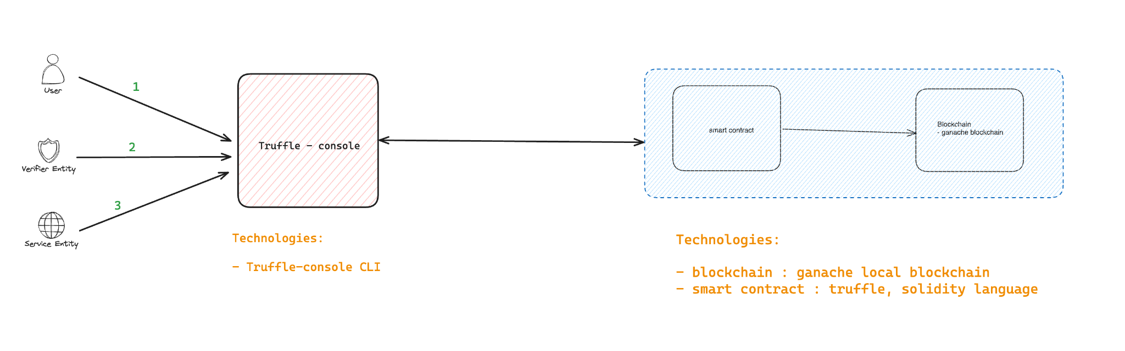
High Level Architecture Diagram
Phase 1

Slide 5
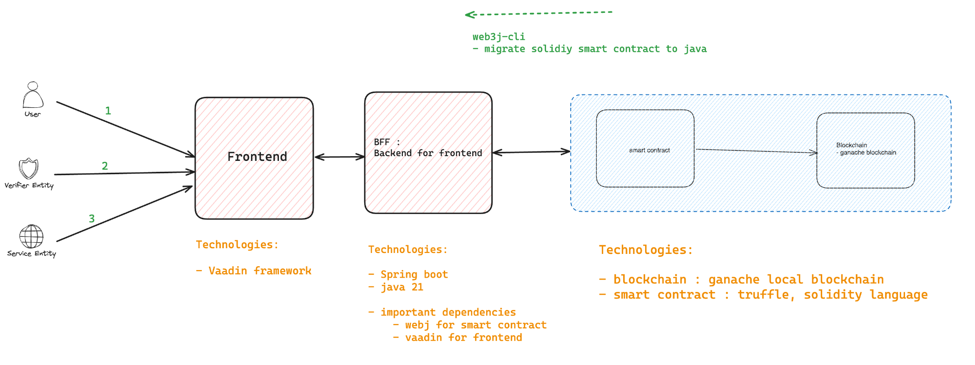
High Level Architecture Diagram
Phase 2

Slide 6
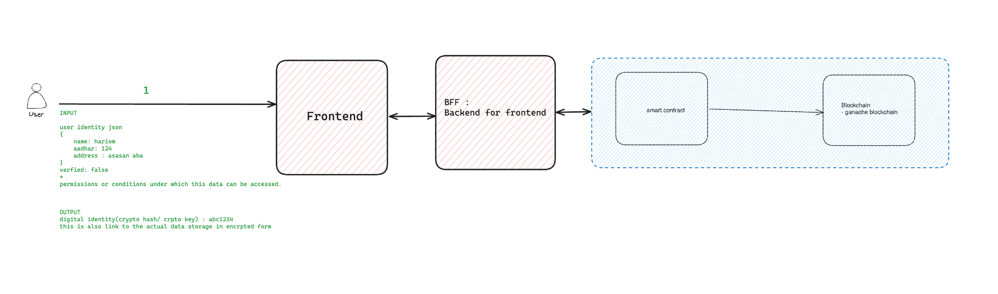
Use case - step 1

Slide 7
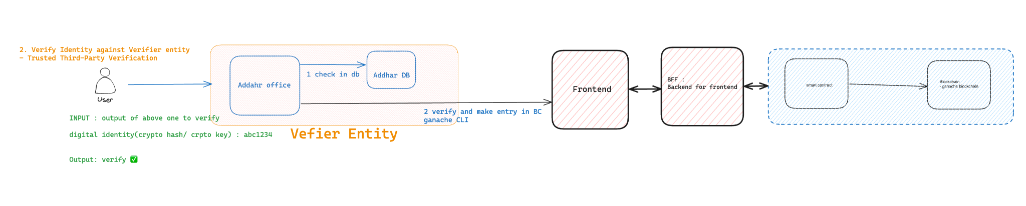
Use case - step 2

Slide 8
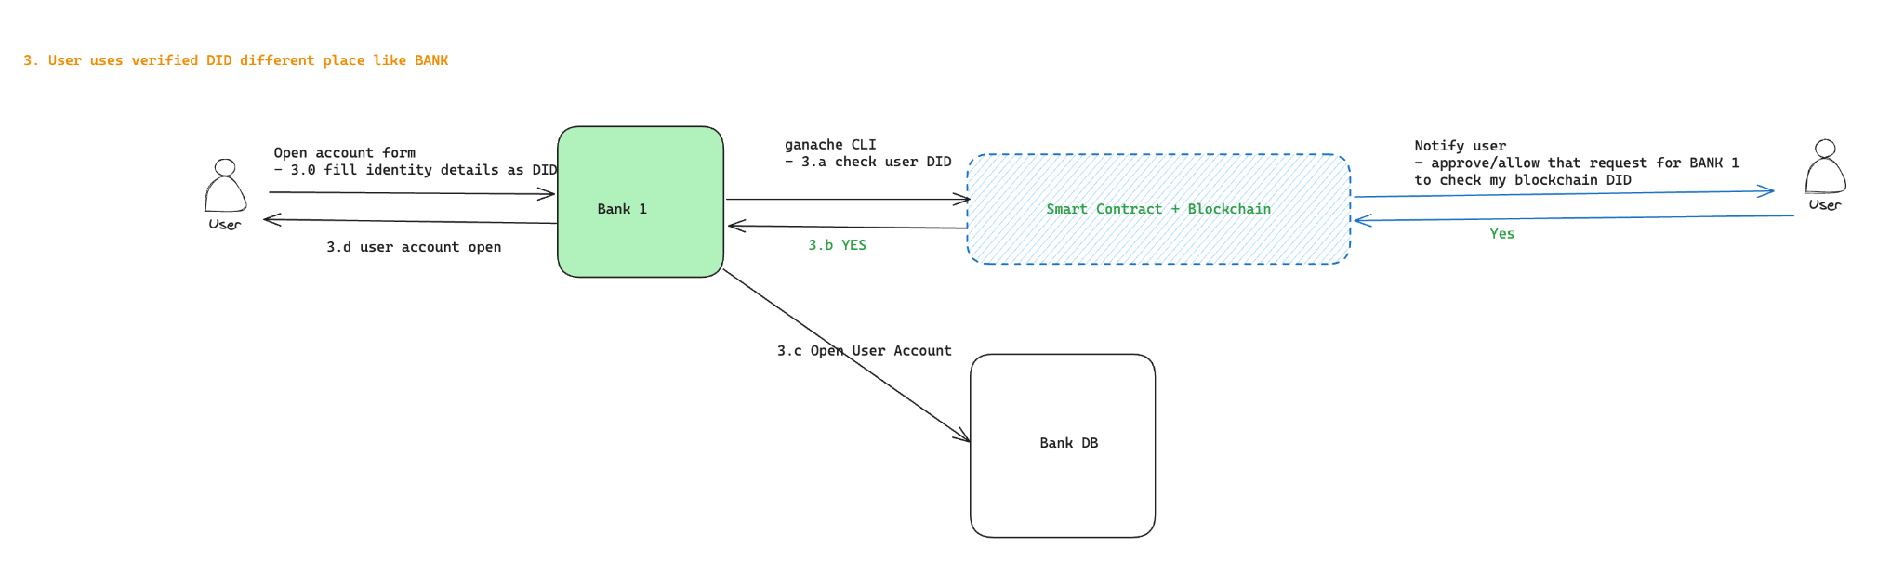
Use case

Slide 9
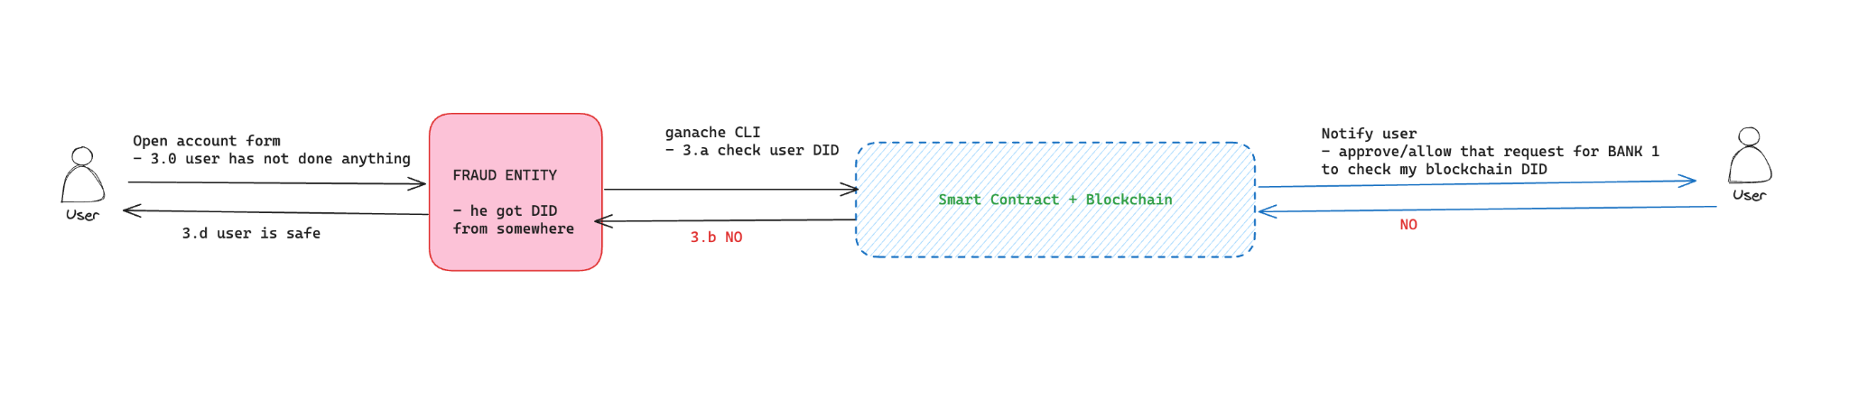
Use case

Slide 10
Demo

Slide 11
End to End Integration
& Code Implementation

Slide 12
Q & A

